Slide 1
Computer Vision
Part 2: Modern Image Segmentation
ADF – Start 08:30

Slide 2

Agenda
Part 1: Classic Image Segmentation
Thresholding, Region, Clustering
Part 2: Modern Image Segmentation
Semantic Segmentation
Instance Segmentation
Computer Vision

Slide 3
Semantic Segmentation
Computer Vision

Slide 4
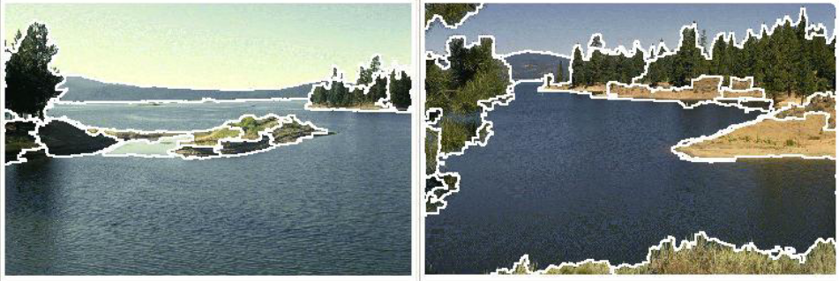
Image Segmentation
Divide input image into regions or sections or parts or segments
Pixels inside a segment have similar properties/features
No clear and apparent meaning of what each segment is representing
Computer Vision

Slide 5
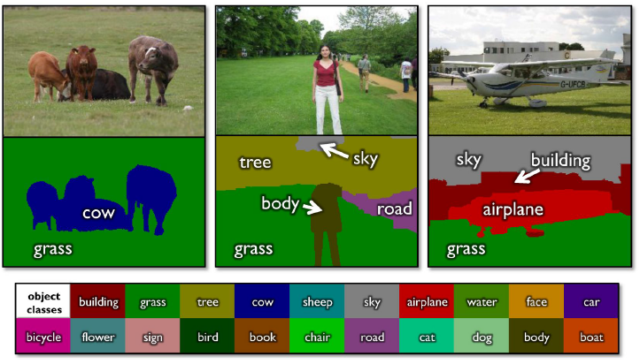
Semantic Segmentation
Classic Computer Vision problem
Input image, fixed number of classes
Goal: Label every pixel
Shotton et al, "TextonBoost for Image Understanding: Multi-Class Object Recognition and Segmentation by Jointly Modeling Texture, Layout, and Context", IJCV 2007
Computer Vision

Slide 6
Semantic Segmentation
Give higher level of understanding than just producing single class
Applications
Autonomous navigation
Partially sighted Assistance
Medical diagnosis
Image editing
Computer Vision

Slide 7
Semantic Segmentation
Shotton et al, "TextonBoost for Image Understanding: Multi-Class Object Recognition and Segmentation by Jointly Modeling Texture, Layout, and Context", IJCV 2007
Computer Vision

Slide 8
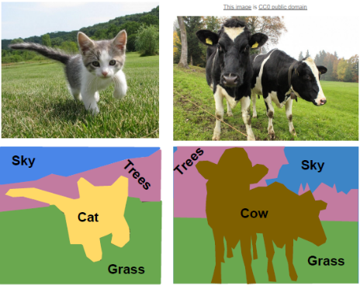
Semantic Segmentation
Early Problems
Did not use deep learning
Do not differentiate instances
only care about pixels
Not quite informative
Computer Vision

Slide 9
Semantic Segmentation as Classification
Computer Vision

Slide 10
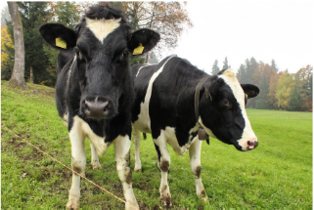
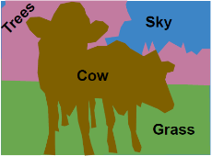
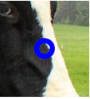
Semantic Segmentation: Sliding Window
Extract patch
Classify
center pixel
COW
CNN
Run through
a CNN
Repeat for
Every pixel
Expensive Routines
Perform independently
Not reusing shared features between overlapping patches
Very “R-CNN” like
Computer Vision

Slide 11
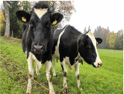

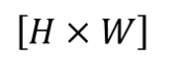
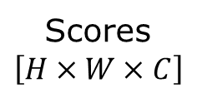
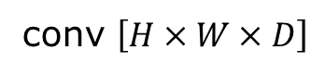
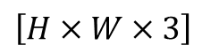
Semantic Segmentation: Fully Convolutional Network
Design a network as a bunch of convolutional layers to make predictions for pixels all at once!
Conv
Conv
Conv
Conv
argmax
$$\left[H×W×3\right]$$
$$\left[H×W\right]$$
Scores $$\left[H×W×C\right]$$
conv $\left[H×W×D\right]$
Effective receptive field is linear
convolutions at original image resolution will be very expensive ...
Computer Vision

Slide 12
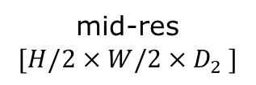
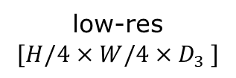
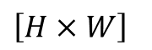
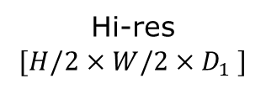
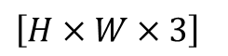
Semantic Segmentation: Fully Convolutional Network
Design a network as a bunch of convolutional layers with downsampling and upsampling inside the network!
mid-res
$$[H/2×W/2×D_{2} ]$$
$$\left[H×W×3\right]$$
low-res
$$[H/4×W/4×D_{3} ]$$
$$\left[H×W\right]$$
Hi-res
$$[H/2×W/2×D_{1} ]$$
Computer Vision

Slide 13
Semantic Segmentation: Fully Convolutional Network
Downsampling
Pooling
Strided Convolution
Upsampling
???
Computer Vision

Slide 14
In-Network Upsampling: "Unpooling"
Computer Vision

Slide 15
In-Network Upsampling: "Bed of Nails“ Unpooling
1 | 0 | 2 | 0
0 | 0 | 0 | 0
3 | 0 | 4 | 0
0 | 0 | 0 | 0
1 | 2
3 | 4
input 2x2
output 4x4
Computer Vision

Slide 16
In-Network Upsampling: Nearest Neighbor Unpooling
1 | 1 | 2 | 2
1 | 1 | 2 | 2
3 | 3 | 4 | 4
3 | 3 | 4 | 4
1 | 2
3 | 4
input 2x2
output 4x4
Computer Vision

Slide 17
In-Network Upsampling: Bilinear Interpolation
Use two closest neighbors in x and y to construct linear approximations
1.00 | 1.25 | 1.75 | 2.00
1.50 | 1.75 | 2.25 | 2.50
2.50 | 2.75 | 3.25 | 3.50
3.00 | 3.25 | 3.75 | 4.00
1 | 2
3 | 4
input 2x2
output 4x4
Computer Vision

Slide 18
In-Network Upsampling: Bicubic Interpolation
Use three closest neighbors in x and y to construct cubic approximations
(This is how we normally resize images!)
0.68 | 1.02 | 1.56 | 1.89
1.35 | 1.68 | 2.23 | 2.56
2.44 | 2.77 | 3.32 | 3.65
3.11 | 3.44 | 3.98 | 4.32
1 | 2
3 | 4
input 2x2
output 4x4
Computer Vision

Slide 19
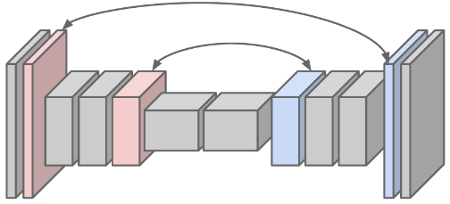
In-Network Upsampling: “Max Unpooling”
Keep corresponding pairs of downsampling and upsampling layers
Max Pooling: Remember which element was max!
Max Unpooling: Use positions from pooling layer
Computer Vision

Slide 20
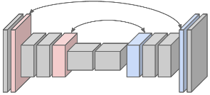
"Max Unpooling" Unpooling
Max Pooling
Remember which element was max!
Max Unpooling
Use positions from pooling layer
1 | 2 | 6 | 3
3 | 5 | 2 | 1
1 | 2 | 2 | 1
7 | 3 | 4 | 8
0 | 0 | 2 | 0
0 | 1 | 0 | 0
0 | 0 | 0 | 0
3 | 0 | 0 | 4
5 | 6
7 | 8
1 | 2
3 | 4
output 2x2
input 4x4
input 2x2
output 4x4
Computer Vision

Slide 21
In-Network Upsampling: Transpose Convolution
Computer Vision

Slide 22


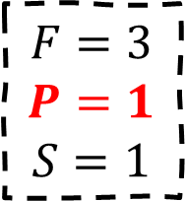
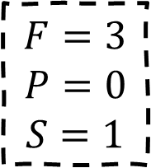
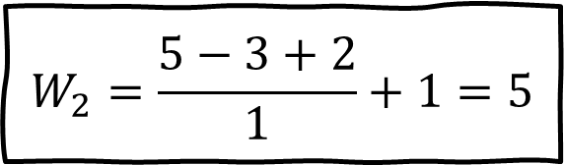
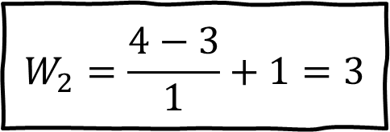
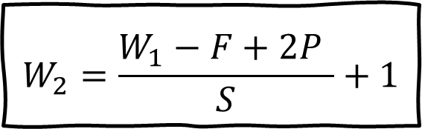
Normal 3x3 Convolution
$$W_{2}=\frac{W_{1}−F+2P }{S}+1$$
$$F=3$$
$$P=0$$
$$S=1$$
$$F=3$$
$$P=1$$
$$S=1$$
$$W_{2}=\frac{4−3}{1}+1=3$$
$$W_{2}=\frac{5−3+2}{1}+1=5$$
Computer Vision

Slide 23

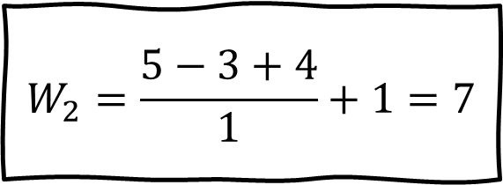
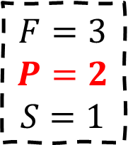
Normal 3x3 Convolution
$$W_{2}=\frac{W_{1}−F+2P }{S}+1$$
$$F=3$$
$$P=2$$
$$S=1$$
$$W_{2}=\frac{5−3+4}{1}+1=7$$
Computer Vision

Slide 24
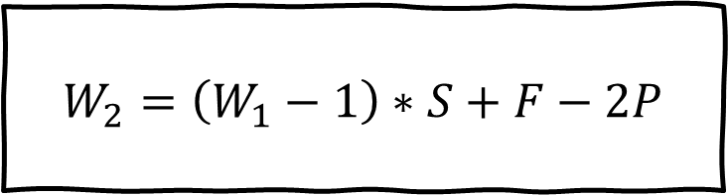
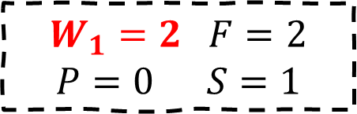
Transpose Convolution
$$W_{2}=\left(W_{1}−1\right)∗S+F−2P$$
$$W_{1}=2 F=2$$
$$P=0 S=1$$
Computer Vision

Slide 25
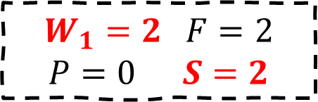
Transpose Convolution
$$W_{2}=\left(W_{1}−1\right)∗S+F−2P$$
$$W_{1}=2 F=2$$
$$P=0 S=2$$
Computer Vision

Slide 26
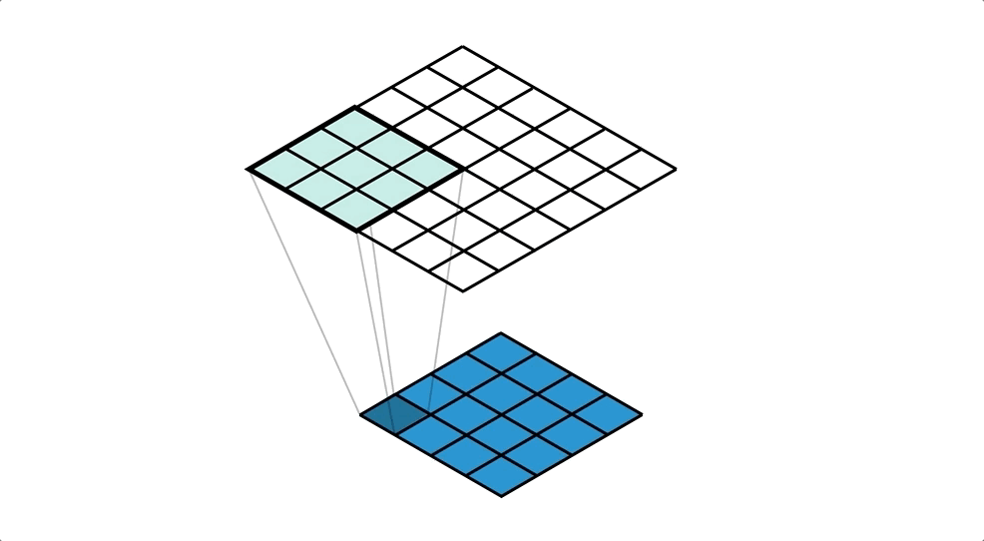
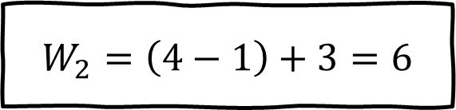
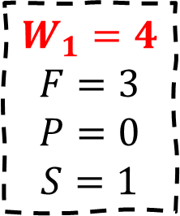

Transpose Convolution
$$W_{2}=\left(W_{1}−1\right)∗S+F−2P$$
$$W_{1}=4$$
$$F=3$$
$$P=0$$
$$S=1$$
$$W_{2}=\left(4−1\right)+3=6$$
Computer Vision

Slide 27
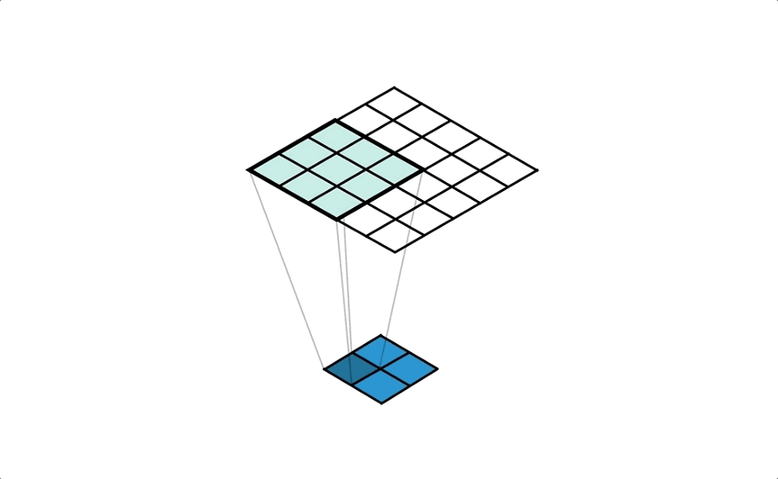
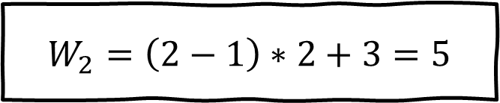
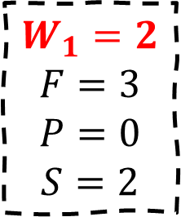
Transpose Convolution
$$W_{2}=\left(W_{1}−1\right)∗S+F−2P$$
$$W_{1}=2$$
$$F=3$$
$$P=0$$
$$S=2$$
$$W_{2}=\left(2−1\right)∗2+3=5$$
Computer Vision

Slide 28
Transpose Convolution
Stride gives ratio between movement in output and input
Other names:
Deconvolution (bad name)
Upconvolution
Computer Vision

Slide 29
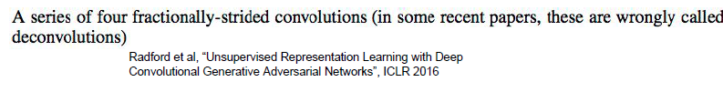
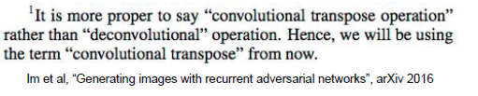
Learnable Upsampling: "Deconvolution"
"Deconvolution" is a bad name,
already defined as "inverse of convolution"
Computer Vision

Slide 30
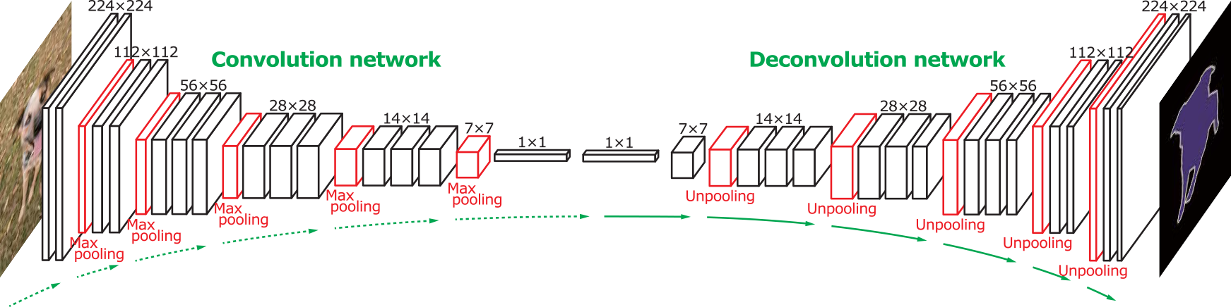
Semantic Segmentation: “Deconvolution” Network
6 days of training on Titan X…
Normal VGG
"Upside down" VGG
Noh et al, "Learning Deconvolution Network for Semantic Segmentation", ICCV 2015
Computer Vision

Slide 31
Semantic Segmentation
Noh et al, "Learning Deconvolution Network for Semantic Segmentation", ICCV 2015
Computer Vision

Slide 32
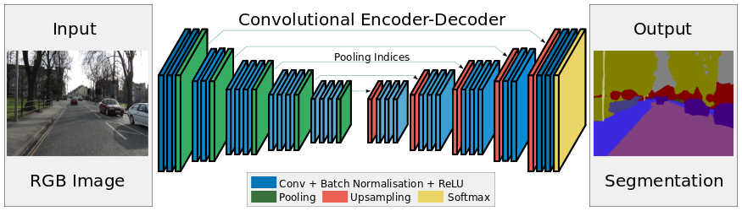
Semantic Segmentation: SegNet
Normal VGG without FC Layers
V Badrinarayanan , et al., A Deep Convolutional Encoder Decoder Architecture for Robust Semantic Pixel Wise Labelling, 2015
Computer Vision

Slide 33
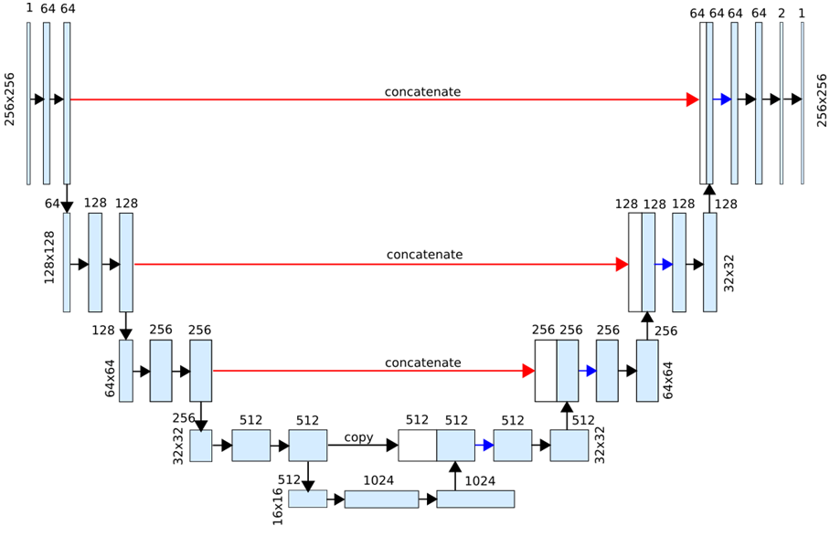
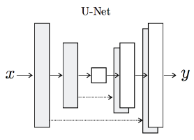
Semantic Segmentation: U-Net
Olaf Ronneberger , Philipp Fischer, Thomas Brox “U Net: Convolutional Networks for Biomedical Image Segmentation”, MICCAI, 2015
Computer Vision

Slide 34
Instance Segmentation
Computer Vision

Slide 35
Things and Stuff
Things:
Object categories that can be separated into object instances
(e.g., cats, cars, person)
Stuff:
Object categories that cannot be separated into instances
(e.g., sky, grass, water, trees)
Computer Vision

Slide 36
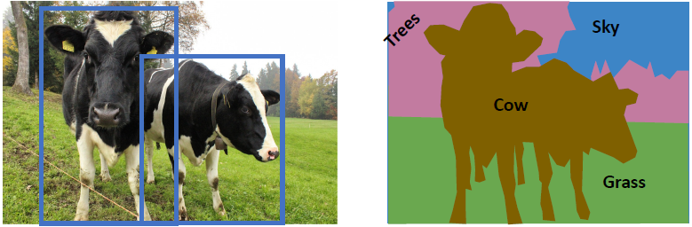
Computer Vision Tasks
Object Detection
Detects individual object instances, but only gives box (Only things!)
Semantic Segmentation
Gives per-pixel labels, but merges instances (Both things and stuff)
Computer Vision

Slide 37
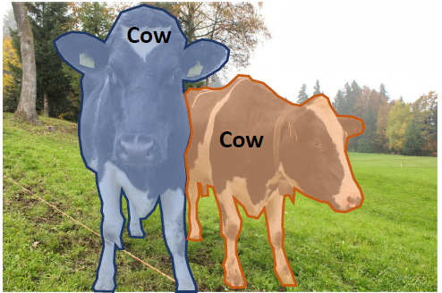
Instance Segmentation
Detect all objects in the image
and identify the pixels that belong to each object
(Only things!)
Computer Vision

Slide 38
Instance Segmentation
Detect instances, give category, label Pixels
"simultaneous detection and segmentation" (SDS)
Input image, fixed number of classes
Goal: output every instance, segment all the pixel belongs to the instance
Lots of recent work (MS-COCO)
Computer Vision

Slide 39
Instance Segmentation Approach
Perform object detection, then
predict a segmentation mask for each object!
Computer Vision

Slide 40
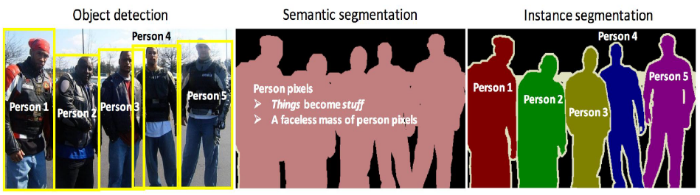
Instance Segmentation
Computer Vision

Slide 41
Mask R-CNN
Computer Vision

Slide 42
Mask R-CNN
State of art in terms of instance segmentation
Two stages
generates region proposals
predicts the class of the object, refines the bounding box and generates pixel level mask
Both stages are connected to the backbone structure.
Computer Vision

Slide 43
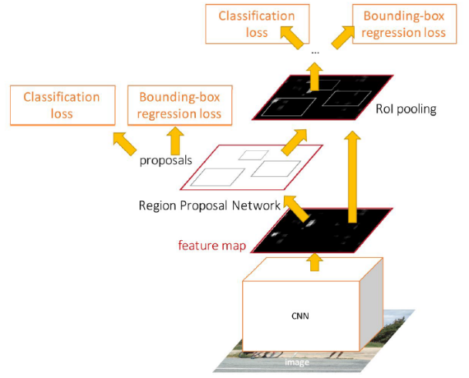
Faster R-CNN
Ren et al, “Faster R-CNN: Towards Real-Time Object Detection with Region Proposal Networks”, NeurIPS 2015
Computer Vision

Slide 44
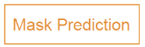
Mask R-CNN
Add a small mask network that operates on each RoI and predicts a 28x28 binary mask
He et al, “Mask R-CNN”, ICCV 2017
Computer Vision

Slide 45
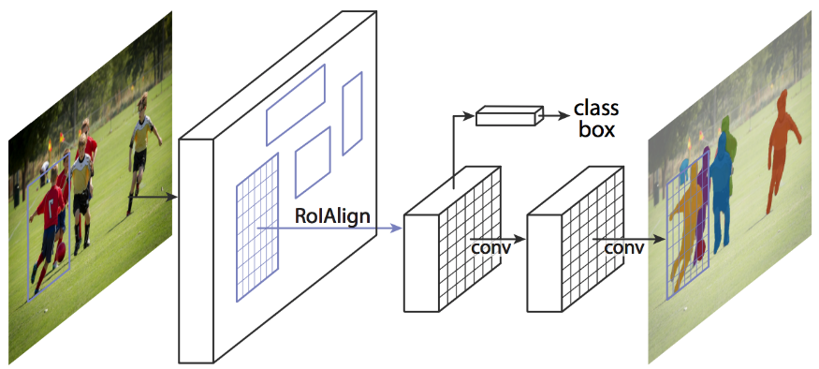
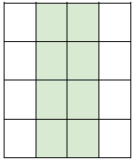
Mask R-CNN
Classification Scores: C
Box coordinates (per class):
4 * C
Predict a mask for
each of C classes:
28x28xC
CNN
+RPN
14x14x256
14x14x256
He et al, “Mask R-CNN”, ICCV 2017
Computer Vision

Slide 46
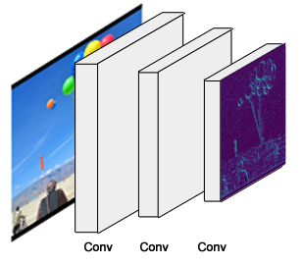
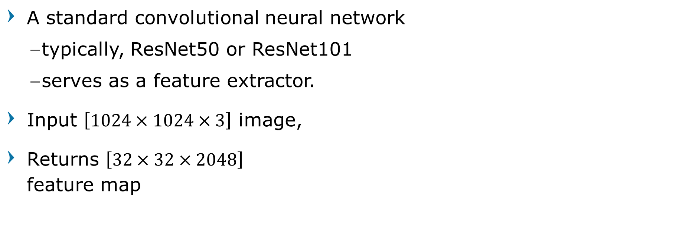
Mask R-CNN - Backbone
A standard convolutional neural network
typically, ResNet50 or ResNet101
serves as a feature extractor.
Input $\left[1024×1024×3\right]$ image,
Returns $\left[32×32×2048\right]$ feature map
He et al, “Mask R-CNN”, ICCV 2017
Computer Vision

Slide 47
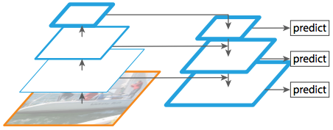
Mask R-CNN - Feature Pyramid Network
An extension that can better represent objects at multiple scales. Improves the standard feature extraction pyramid
Adding a second pyramid that takes the high-level features from the 1st pyramid and passes them down to lower layers.
Allows features at every level to have access to both, lower and higher level features.
He et al, “Mask R-CNN”, ICCV 2017
Computer Vision

Slide 48

Mask R-CNN
He et al, “Mask R-CNN”, ICCV 2017
Computer Vision

Slide 49

Mask R-CNN
He et al, “Mask R-CNN”, ICCV 2017
Computer Vision

Slide 50
Mask R-CNN Example Training Target
Computer Vision

Slide 51

Mask R-CNN: Very Good Results!
He et al, “Mask R-CNN”, ICCV 2017
Computer Vision

Slide 52

Mask R-CNN: Very Good Results!
He et al, “Mask R-CNN”, ICCV 2017
Computer Vision

Slide 53

Mask R-CNN: Very Good Results!
He et al, “Mask R-CNN”, ICCV 2017
Computer Vision

Slide 54


Mask R-CNN: Very Good Results!
He et al, “Mask R-CNN”, ICCV 2017
Computer Vision

Slide 55

Mask R-CNN: Also does pose!
He et al, “Mask R-CNN”, ICCV 2017
Computer Vision

Slide 56

Mask R-CNN
Add another mask network to perform keypoint prediction
He et al, “Mask R-CNN”, ICCV 2017
Computer Vision

Slide 57

Mask R-CNN
Ground-truth has one “pixel” turned on per keypoint. Train with softmax loss
He et al, “Mask R-CNN”, ICCV 2017
Computer Vision

Slide 58

Mask R-CNN: Very Good Results!
He et al, “Mask R-CNN”, ICCV 2017
Computer Vision

Slide 59

Mask R-CNN: Very Good Results!
He et al, “Mask R-CNN”, ICCV 2017
Computer Vision

Slide 60
Beyond Instance Segmentation
Computer Vision

Slide 61

Computer Vision Tasks
Instance Segmentation
Separate object instances, but only things
Semantic Segmentation
Identify Both things and stuff, but doesn’t separate instances
Computer Vision

Slide 62

Beyond: Panoptic Segmentation
Label all pixels in the image (both things and stuff)
For “thing” categories also separate into instances
Kirillov et al, “Panoptic Segmentation”, CVPR 2019
Kirillov et al, “Panoptic Feature Pyramid Networks”, CVPR 2019
Computer Vision

Slide 63
Beyond: Panoptic Segmentation
Kirillov et al, “Panoptic Feature Pyramid Networks”, CVPR 2019
Computer Vision

Slide 64
General Idea:
Add Per-Region “Heads” to Faster/Mask R-CNN
Each receives the features after RoI Pool / RoI Align, makes some prediction per-region
Computer Vision

Slide 65

Dense Captioning
Predict a caption per region!
Computer Vision

Slide 66
Dense Captioning
Computer Vision

Slide 67

Question?
Computer Vision

Slide 68

Next Agenda
Recurrent Neural Network
Image Captioning
Computer Vision

Slide 69
References
Fei-Fei Li, Justin J, Serena Y - Stanford CS231n 2018 Course
Justin Johnson– EECS498 Lectures, University of Michigan
Yogesh Singh Rawat – CAP5415 Lectures, University of Central Florida
Grauman, K. and Leibe, B. 2011. Visual Object Recognition. Synthesis Lectures Artif. Intell. Mach. Learn. 5, 1 181
Computer Vision
Notes:
http://jefkine.com/general/2016/09/05/backpropagation-in-convolutional-neural-networks/
https://grzegorzgwardys.wordpress.com/2016/04/22/8/
http://andrew.gibiansky.com/blog/machine-learning/convolutional-neural-networks
http://www.slideshare.net/kuwajima/cnnbp
http://soumith.ch/ex/pages/2014/08/07/why-rotate-weights-convolution-gradient

